Slide 1
PUCKFish
The Modern Trapping Solution
Will Aracri, Peter Ha, Ammar Hussain, Alex Necekov, Victoria Thomas

Slide 2
The Problem
Fisheries have a regulatory cap on how many traps they can place, and where they can place them
Trappers are forced to guess at lobster clusters
There is no effective way to optimise trap placement without up to date data
Trappers currently make heavy use of incomplete, unreliable historical data
No solution to trappers’ data needs exists

Slide 3
What is PUCKFish
PUCKFish provides trappers with the tools of the 21st century
Data collection on each trap
More efficient trap placement
Fewer traps
Collects all the most useful data for finding lobster pods based on the biology of lobsters
Active data collection for up to 10 days
Wirelessly transmits data back to a base station when surfaced

Slide 4
Product Visualization
Hole for Dissolved Oxygen Sensor
Hole for Pressure Sensor
Microcontroller
Accelerometer
Microcontroller
SD Card
Battery
Temperature Sensor
PUCKFish Unit
Base Station

Slide 5
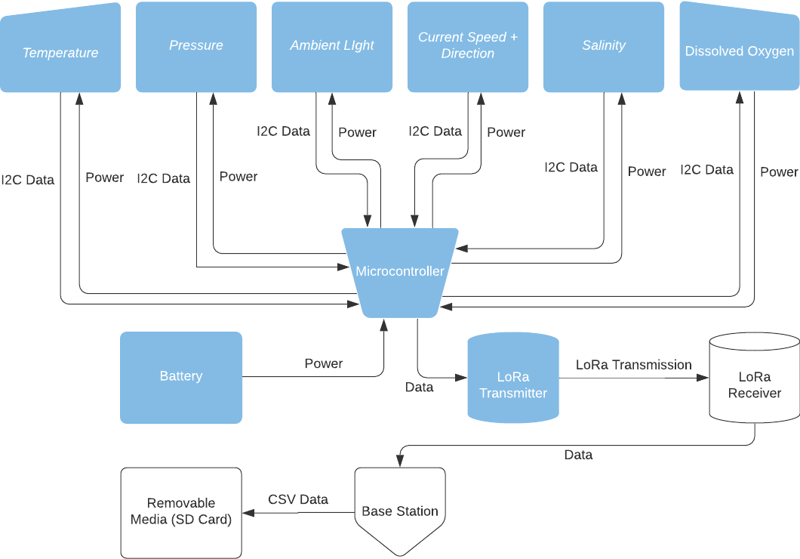

Slide 6
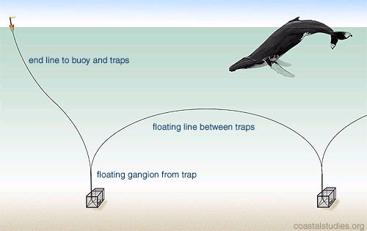

System Visualization
Current System
Our Solution
Gathers data about dissolved oxygen, pressure and floor conditions
Many, potentially inefficient traps, no data
Fewer, better placed traps informed by data
Notes:
Our device will be compatible with lineless buoys or reduce line waste for lined buoys

Slide 7
Development Path
Prototype Stage (1-2 Months)
A functional sensing device that successfully collects data while submerged
Final Stage (6-8 Months)
Three PUCKFish underwater sensing devices
Base station for data transmission
Easy charging solution
Accompanying documentation

Slide 8
Technical Details
Collect information about water in area around trap
Dissolved Oxygen
Depth
Salinity
Temperature
Water Current Velocity
Ambient Light
Polls sensors once per hour
Last 10 days off of a single charge

Slide 9
Features
Compact form factor
Rechargeable with shipboard marine batteries
Robust enough to withstand constant marine conditions
Automatically detects when the trap is activated
Transmits data to shipboard base station when trap surfaces, stored in common devices and formats.
Unit cost < $50 at scale, $150 for prototype

Slide 10
Competitive Niche
Competitors are grouped into the following categories
Non-Competitors
Similar goals to PUCKFish but approached the problem from a different perspective
Minor Competitors
Same goals and approached the problem in the same way as PUCKFish, fewer performance requirements and/or are inoperable or off-the-grid
Major Competitors
These projects had the same goals and approached the problem in the same way as PUCKFish. Our design seeks to outcompete these competitors through additional features and enhanced performance

Slide 11
Competitors
Product | Dev Time (Months) | Temp | Oxygen | Depth | Salinity | Current Values | Ambient Light
PUCKFish | 6 | 1 | 1 | 1 | 1 | 1 | 1
Major
TimeZero | 6 | 1 | 1 | 1 | 1 | 1 | 0
eMOLT | 0 | 1 | 0 | 0 | 1 | 1 | 0
Minor
LobsterNet | 14 | 1 | 1 | 1 | 0 | 0 | 0
Oregon State U | 0 | 1 | 1 | 0 | 0 | 0 | 0
Non
LasTrap | 0 | 0 | 0 | 0 | 0 | 0 | 0
LobsterLift | 8 | 0 | 0 | 0 | 0 | 0 | 0
Notes:
Will

Slide 12
Questions?

